Slide 1
Skepticamp words important to skepticism
Skeptics
Humanists
Atheists
Saturday, March 28, 2009

Slide 2
About the Venn Diagram
Skeptics
Humanists
Atheists
Skeptics
Humanists
Atheists
Drew it this way because it’s pretty
Actually it’s more like this

Slide 3
Welcome
Mission Statement of the Skeptics of Tucson
  We are a social group composed of diverse individuals who share a common interest in promoting the understanding and application of critical thinking skills and scientific methodology in the explanation of human experience — from the seemingly mundane to the alleged paranormal.
  Critical thinking consists of mental processes of discernment, analysis and evaluation.

Slide 4
Desired Results of Discussion
Spark questions
Motivate research
Doubt what you hear
Don’t take life decisions based on what you hear at ANY meeting, including a skeptics meeting
Check out everything

Slide 5
Words Important to Skepticism
Skeptic
Critical Thinking
Skeptic vs. Cynic
Observations
Theory
Paradigm

Slide 6
Skeptic
skep⋅tic
/ˈskɛptɪk/ Show Spelled Pronunciation [skep-tik] Show IPA –noun
1. a person who questions the validity or authenticity of something purporting to be factual.
2. a person who maintains a doubting attitude, as toward values, plans, statements, or the character of others.
3. a person who doubts the truth of a religion, esp. Christianity, or of important elements of it.
4. (initial capital letter) Philosophy.
a. a member of a philosophical school of ancient Greece, the earliest group of which consisted of Pyrrho and his followers, who maintained that real knowledge of things is impossible.
b. any later thinker who doubts or questions the possibility of real knowledge of any kind.

Slide 7
Who’s the skeptic?
Susan Blackmore
Richard Dawkins
David Deutsch
Chris French
Martin Gardner
Nicholas Humphrey
Mike Hutchison
Ray Hyman
Paul Kurtz
David Marks
James Randi
Michael Shermer
Richard Wiseman
Lewis Wolpert
Tony Youens
Brian Dunning
Ben Stein
Rupert Sheldrake
Alex Tsakiris
David Ray Griffin
Steven Jones
James Fetzer
Kent Hovind
Ken Hamm
Charlie

Slide 8
What I’ve Heard
Promotional products keynote speaker
  Earth climate change and Mars?
  Frank Antenori (AZ Conservative Politician)
  National Review
At a party
  “I’m a skeptic. I don’t trust the scientists”
Penn Gillette
  “I loathe everything about Al Gore, so since Gore has been crusading against climate change it must be garbage.”

Slide 9
Critical Thinking
Critical thinking is the careful, deliberate determination of whether we should accept, reject, or suspend judgment about a claim and the degree of confidence with which we accept or reject it. It is a purposeful and reflective judgment about what to believe or what to do in response to observations, experience, verbal or written expressions, or arguments. Critical thinking might involve determining the meaning and significance of what is observed or expressed, or, concerning a given inference or argument, determining whether there is adequate justification to accept the conclusion as true. Hence, Fisher & Scriven define critical thinking as "Skilled, active, interpretation and evaluation of observations, communications, information, and argumentation."
Critical thinking gives due consideration to the evidence, the context of judgment, the relevant criteria for making the judgment well, the applicable methods or techniques for forming the judgment, and the applicable theoretical constructs for understanding the nature of the problem and the question at hand. Critical thinking employs not only logic but broad intellectual criteria such as clarity, credibility, accuracy, precision, relevance, depth, breadth, significance and fairness.
In contemporary usage "critical" has the connotation of expressing disapproval, which is not always true of critical thinking. A critical evaluation of an argument, for example, might conclude that it is good.

Slide 10
An Aside
Preparing for retirement about 3 years ago I needed a cause—Advance the Cause of Reason (Rationality, Skepticism, Atheism, Humanism, Critical Thinking)
So…when my friend asked what I was going to do after retirement?...
“…but you can’t be a skeptic. You seem like such a positive person.”
“I think you’re confusing skeptic with cynic”

Slide 11
Skeptic vs Cynic
Cynic:
  1. a person who believes that only selfishness motivates human actions and who disbelieves in or minimizes selfless acts or disinterested points of view.
  2. (initial capital letter) one of a sect of Greek philosophers, 4th century BCE, who advocated the doctrines that virtue is the only good, that the essence of virtue is self-control, and that surrender to any external influence is beneath human dignity.
  3. a person who shows or expresses a bitterly or sneeringly cynical attitude.

Slide 12
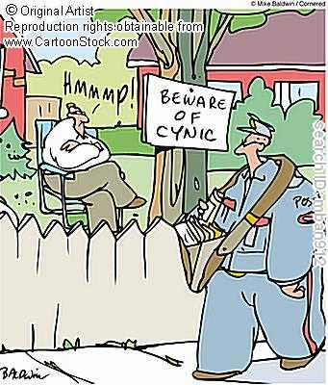
Skeptic vs Cynic

Slide 13
Skeptic vs Cynic
Skepticism is about:
  Science
  Data
  Critical Thinking
Cynicism is about Motivation

Slide 14
Cynic vs Skeptic
Two skeptics can violently disagree and thrash about for an hour and at the end not agree but go get a drink together.
The Hatfields and McCoys were cynics.
Once the arguments start addressing individual motivations, rational discussion ends.
No way to prove a persons motivations.
No hope of reaching consensus.

Slide 15
Uncommon words Used commonly
Observations, Theories, Paradigms

Slide 16
Observations (Facts)
Facts are boring things (lifeless, cold, dead) -Dr Joanna Masel, UofA
I would rather discover a single fact, even a small one, than debate the great issues at length without discovering anything new at all. -Galileo Galilei

Slide 17
Observations (Facts)
Rarely change
Incorporated in new paradigms
Usually non contentious
Example: Fossils
  Fossils exist
  They are bones of previously living creatures

Slide 18
Theories (Interpretations)
Theories are where science happens
A theory, in the general sense of the word, is an analytic structure designed to explain a set of observations. A theory does two things:
  it identifies this set of distinct observations as a class of phenomena, and
  makes assertions about the underlying reality that brings about or affects this class.

Slide 19
Theories (Interpretations)
Gives us the ability to:
  Describe things
  Explain observations
  Predict outcomes
  Act to effect an outcome

Slide 20
Paradigms (More than 20 cents)
General acceptance
Framework (the box)
Universal model
  Few unexplained anomalies
Highly stable, resistant to change
When paradigm shifts occur, they have significant consequences

Slide 21
Paradigm Shifts
The transition from a Ptolemaic cosmology to a Copernican one.
The transition between the worldview of Newtonian physics and the Einsteinian Relativistic worldview.
The acceptance of Plate tectonics as the explanation for large-scale geologic changes.

Slide 22
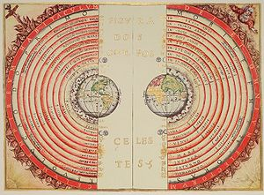
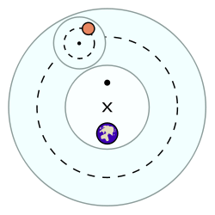
Earth Centered Cosmology
Ptolemaic system
In the Ptolemaic system, each planet is moved by five or more spheres: one sphere is its deferent. The deferent was a circle centered around a point halfway between the equant and the earth. Another sphere is the epicycle which is embedded in the deferent. The planet is embedded in the epicycle sphere. The deferent rotates around the Earth while the epicycle rotates within the deferent, causing the planet to move closer to and farther from Earth at different points in its orbit, and even to slow down, stop, and move backward (in retrograde motion). The epicycles of Venus and Mercury are always centered on a line between Earth and the Sun (Mercury being closer to Earth), which explains why they are always near it in the sky.

Slide 23
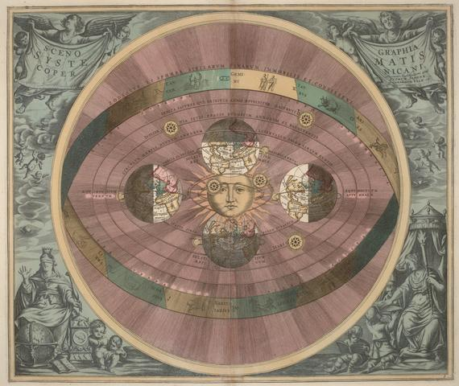
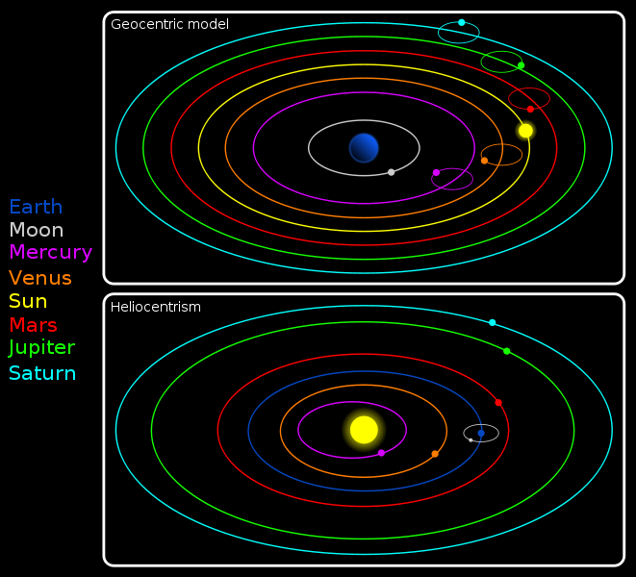
Heliocentric (~1543)
In astronomy, heliocentrism is the theory that the Sun is at the center of the Universe. The word came from the Greek (ήλιος Helios = sun and κέντρον kentron = center). Historically, heliocentrism was opposed to geocentrism, which placed the earth at the center. (The distinction between the Solar System and the Universe was not clear until modern times, but extremely important relative to the controversy over cosmology and religion). Though discussions on the possibility of heliocentrism date to antiquity, it was not until 1,800 years later, however, in the 16th century, that the mathematician and astronomer Copernicus presented a fully predictive mathematical model of a heliocentric system, which was later elaborated and expanded by Johannes Kepler.

Slide 24
Normal Science
In normal science, we are puzzle-solving
The fundamentals of the accepted paradigm are not tested
It is assumed that there are built in mechanisms that cause research to produce results necessitating a paradigm shift when the current one fails to function effectively

Slide 25
Summary
Important Words
  Skeptic
  Critical Thinking
  Skeptic vs. Cynic
  Observations
  Theory
  Paradigm

Slide 26
Closing
“It’s only words, and words are all I have…”
When scientists and engineers use words they must have common well understood meanings.
A journalist can finesse meanings through inexact phrases and secondary meanings.
  (The word bureaucrat for example has a technical and emotional meaning.)

Slide 27
Contact Information
AZAtheist@cox.net
(520) 370-8420
http://www.meetup.com/Skeptics-of-Tucson/
http://www.meetup.com/Tucson-Atheists/

